Slide 1




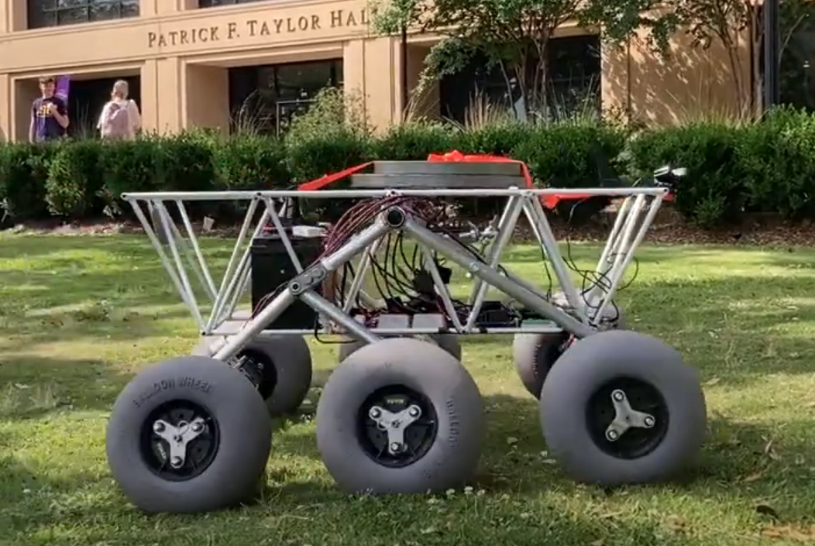
Solar-Powered Rover
Prepared by: Margaret Burkes
Presented by: Margaret Burkes
By Team 66:
William Mancuso (EE), Bowen Williamson (EE), Margaret Burkes (EE), Keldon Ngo (EE), Kenny Bui (EE)
Project Sponsor: Dr. Xiangyu Meng
Faculty Advisor: Dr. Shahab Mehraeen
12/6/2024
#1

Slide 2
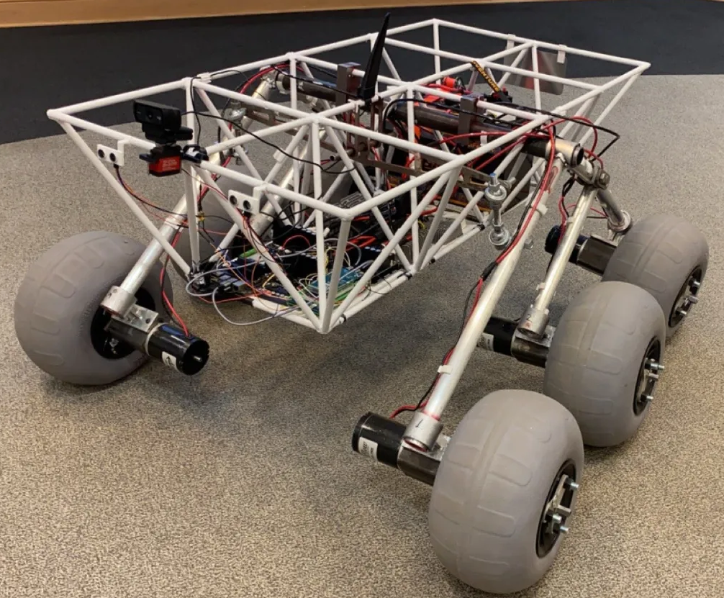
Project Background:
Prepared by: Margaret Burkes
Presented by: Margaret Burkes
Land
Optimized
Upgradeable
Interplanetary
System
12/6/2024
#2

Slide 3
Objective Statement
Prepared by: Bowen Williamson
Presented by: Margaret Burkes
The main objective of this project is enhancing the previously built rover, which is battery powered, by integrating solar power, autonomous power switching between solar and battery power, and an independent cleaning system for the solar panel.
12/6/2024
#3

Slide 4
Customers:
Prepared by: Margaret Burkes
Presented by: Margaret Burkes
Primary: The LSU Electrical Engineering Department can utilize LOUIS for research, development, and educational purposes for their students.
Secondary: Future senior design students can enhance LOUIS’s capabilities to learn more about the design and building process. Additionally, companies can use and adapt this technology for their own purposes.
12/6/2024
#4
Notes:
FIX SPACING

Slide 5
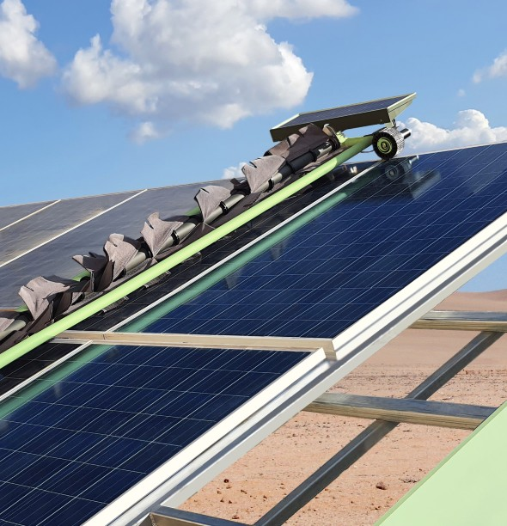
Existing and Competing Technologies:
Prepared by: Keldon Ngo
Presented by: Keldon Ngo
Ecoppia E4:
Key similarities
Solar panel cleaning robot
Bi-directional cleaning
Key Differences
Smart row scanning
Speed adaptability
12/6/2024
#5

Slide 6
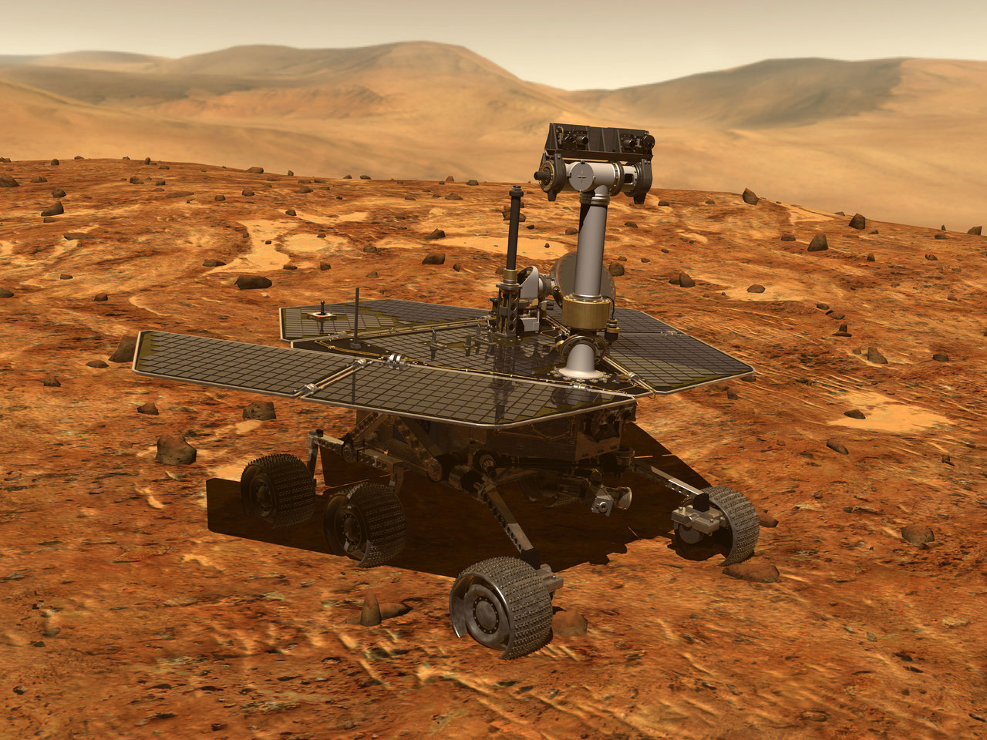
Existing and Competing Technologies:
Prepared by: Keldon Ngo
Presented by: Keldon Ngo
Nasa Spirt Rover:
Key Similarities
Mainly solar power rover
Used for environmental exploration
Key differences
Built for Martian weather
No Self-Cleaning System
12/6/2024
#6

Slide 7
Functional Requirements
Prepared by: William Mancuso
Presented by: William Mancuso
# | Weight | Function | Explanation
F1 | 0.4 | Convert solar energy to power the rover. | Utilize solar panels to absorb sunlight as an additional power source to the battery power.
F2 | 0.35 | Autonomously switch power between power sources. | Autonomously switch between battery and solar power.
F3 | 0.25 | Clean the solar panels. | Intermittently clean off debris from solar panel to maximize energy absorption and efficiency.
12/6/2024
#7

Slide 8
Qualitative Constraints
Prepared by: William Mancuso
Presented by: William Mancuso
# | Weight | Qualitative Constraint | Explanation
Q1 | 0.40 | Compatibility with Existing Design | Make sure that the new implementations to the previous rover are compliant with each other. The additions should merge with the existing design seamlessly.
Q2 | 0.35 | Weatherproof Design | The solar panel system should be built to withstand the elements of Louisiana such as wind, precipitation, and heat.
Q3 | 0.25 | Portability | Make sure that the system doesn’t hinder the transportation of the rover. Should be convenient to maneuver without disassembly.
12/6/2024
#8

Slide 9
Quantitative Constraints
Prepared by: William Mancuso
Presented by: William Mancuso
# | Weight | Name | Symbol | Units | Value(s) | Explanation
M1 | 0.5 | Budget | B | $ | 4000 | A budget of $4000 was decided upon by the sponsor.
M2 | 0.4 | Interior Space | S | M^3 | 0.977 | This is the amount of available space inside the rover’s chassis to install new electronic components.
M3 | 0.1 | Weight Limit | W | Kg | <36.3 | The max additional weight load was measured at 36.3kg. The team would like to stay under this variable.
12/6/2024
#9

Slide 10
Function Objective Tree
Prepared by: Kenny Bui
Presented by: Kenny Bui
Solar-Powered Rover
Clean Solar Panels
Generate Solar Power
Autonomously Switch Power Sources
Activate Brush Cleaning System
Clear Debris Off Of Solar Panel Surface
Timer Based Activation
Detect Power Consumption
Execute Programming For Action
Switch Priority Between Power Sources
Absorb Solar Energy
Convert Solar Rays To Electricity
Supply Power To Rover System and Battery
12/6/2024
#10

Slide 11
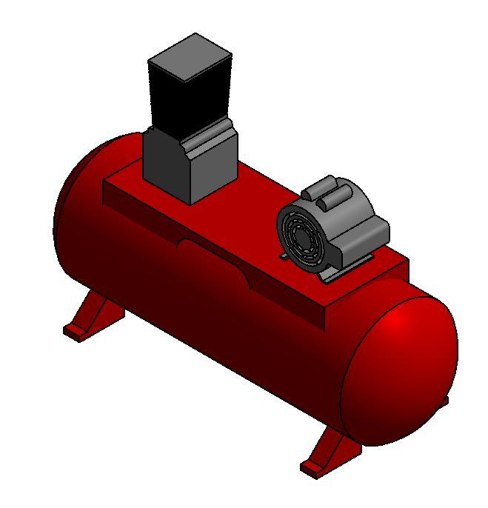
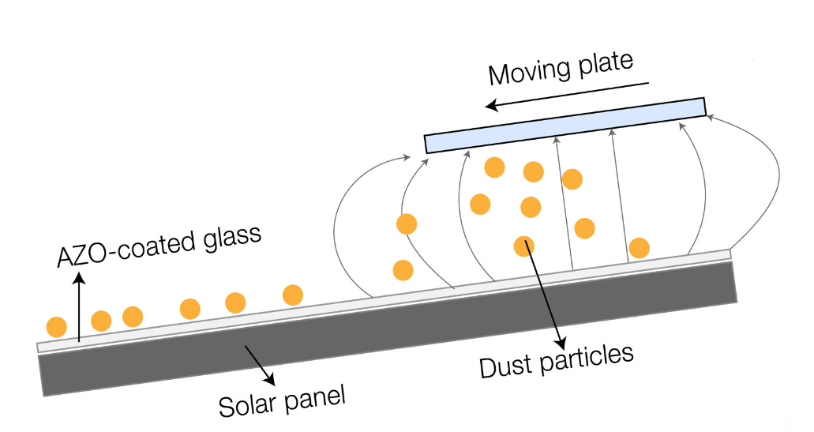
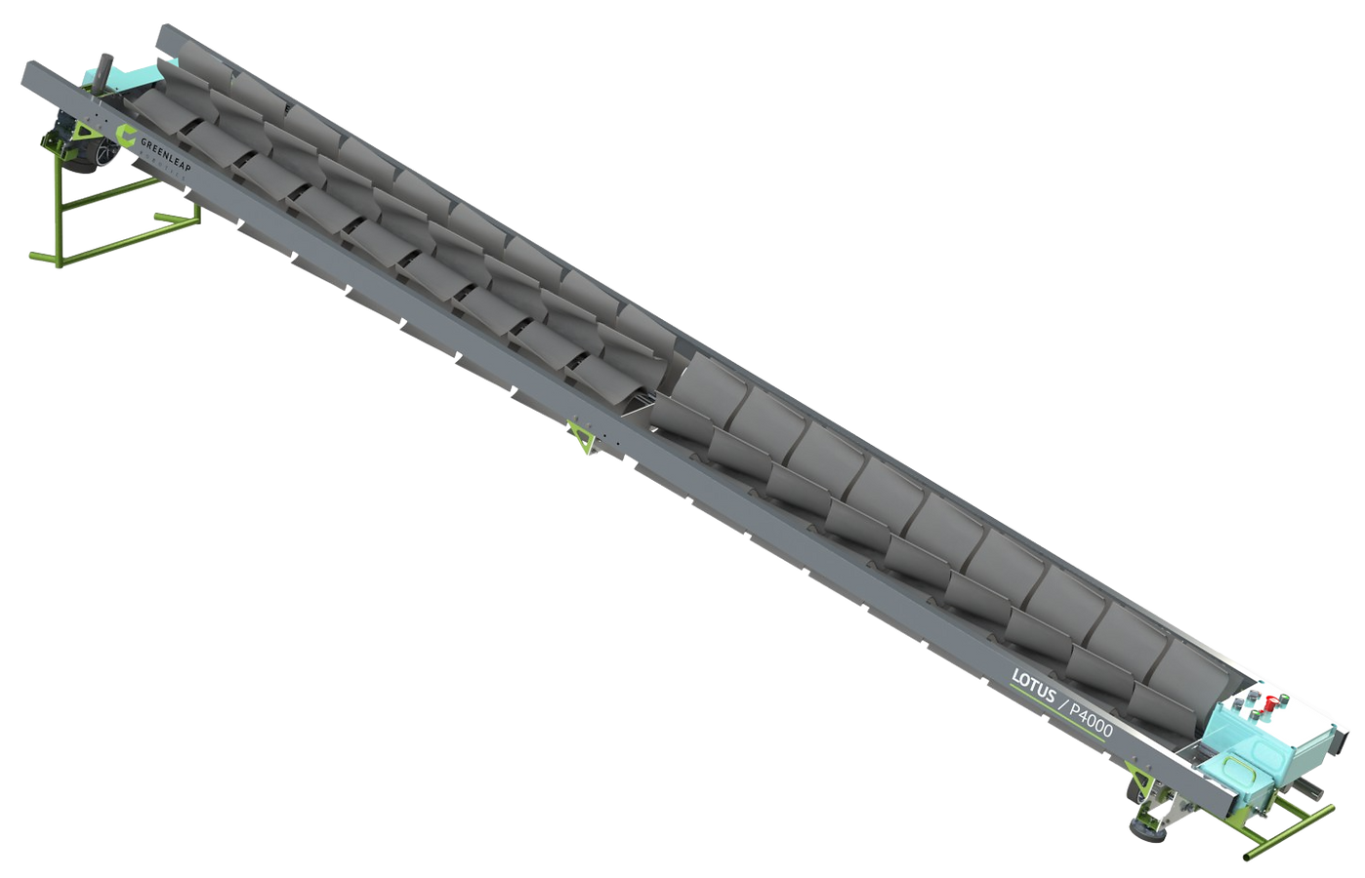
Concept Generation: Self-Cleaning
Prepared by: Margaret Burkes
Presented by: Margaret Burkes
Air Compressor Method
Electrostatic Method
Brush Method
12/6/2024
#11
Notes:
https://designscad.com/downloads/air-compressor-3d-dwg-model-for-autocad/

Slide 12
Concept Evaluation & Selection: Self-Cleaning
Prepared by: Margaret Burkes
Presented by: Margaret Burkes
 |  | Concepts
Criterion | Weights | Air Compressor | Electrostatic Method | Brush Method
Cost | 30 | 0 | -1 | 1
Cleans Effectively | 25 | -1 | 1 | 0
Mass | 20 | -1 | 0 | 1
Non-abrasive | 20 | 0 | 1 | -1
Maintenance | 5 | -1 | 1 | 0
Weighted Total | 100 | -0.5 | 0.2 | 0.3
12/6/2024
#12

Slide 13
Concept Selection:
Prepared by: Margaret Burkes
Presented by: Margaret Burkes
 | Solar Panel Cleaning System | Autonomously Switch Battery | Solar Panel
Concepts | Brush Method | Solar Charge Controller | Monocrystalline
12/6/2024
#13

Slide 14
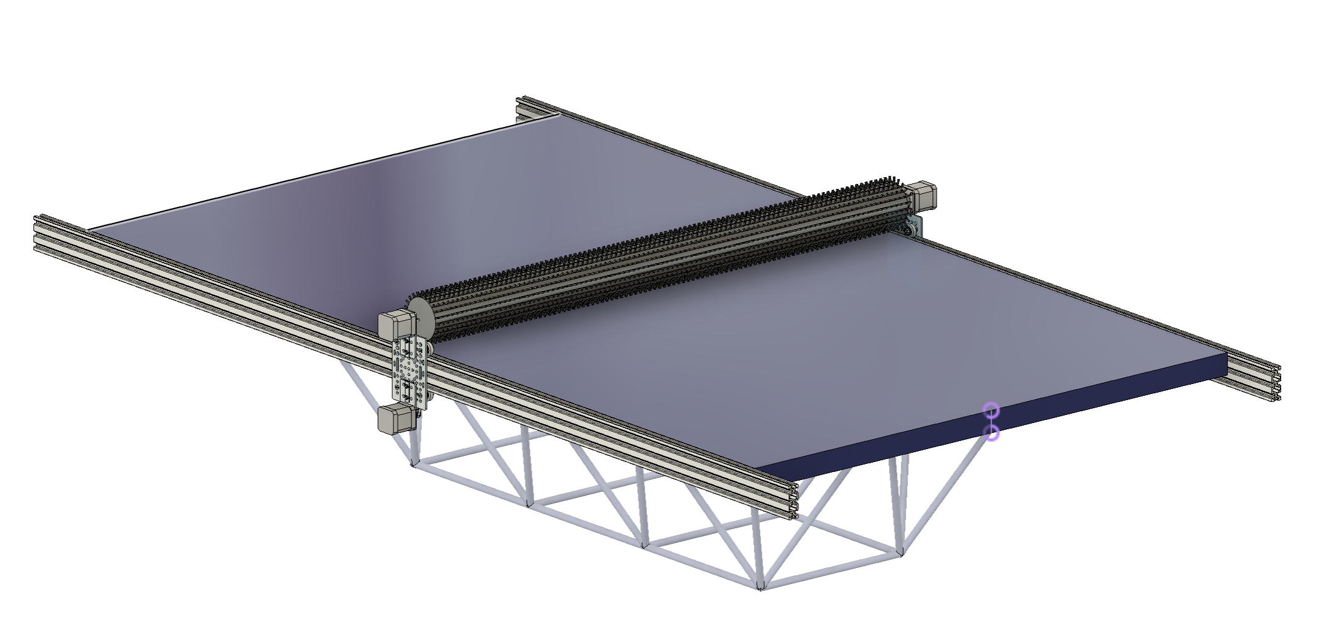
Product Architecture
Prepared by: Bowen Williamson
Presented by: Bowen Williamson
Brush
Solar Panel
Linear Actuators
Rover
12/6/2024
#14

Slide 15
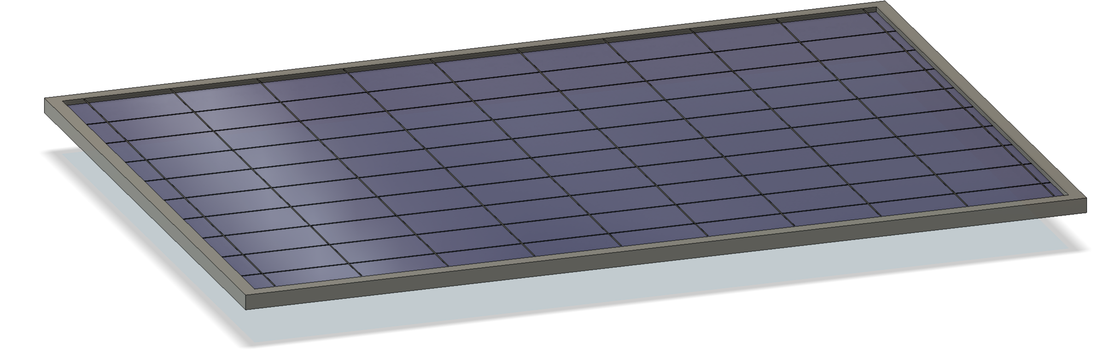
Product Architecture – Solar Panel
Prepared by: Bowen Williamson
Presented by: Bowen Williamson
46 in.
68 in.
12/6/2024
#15

Slide 16
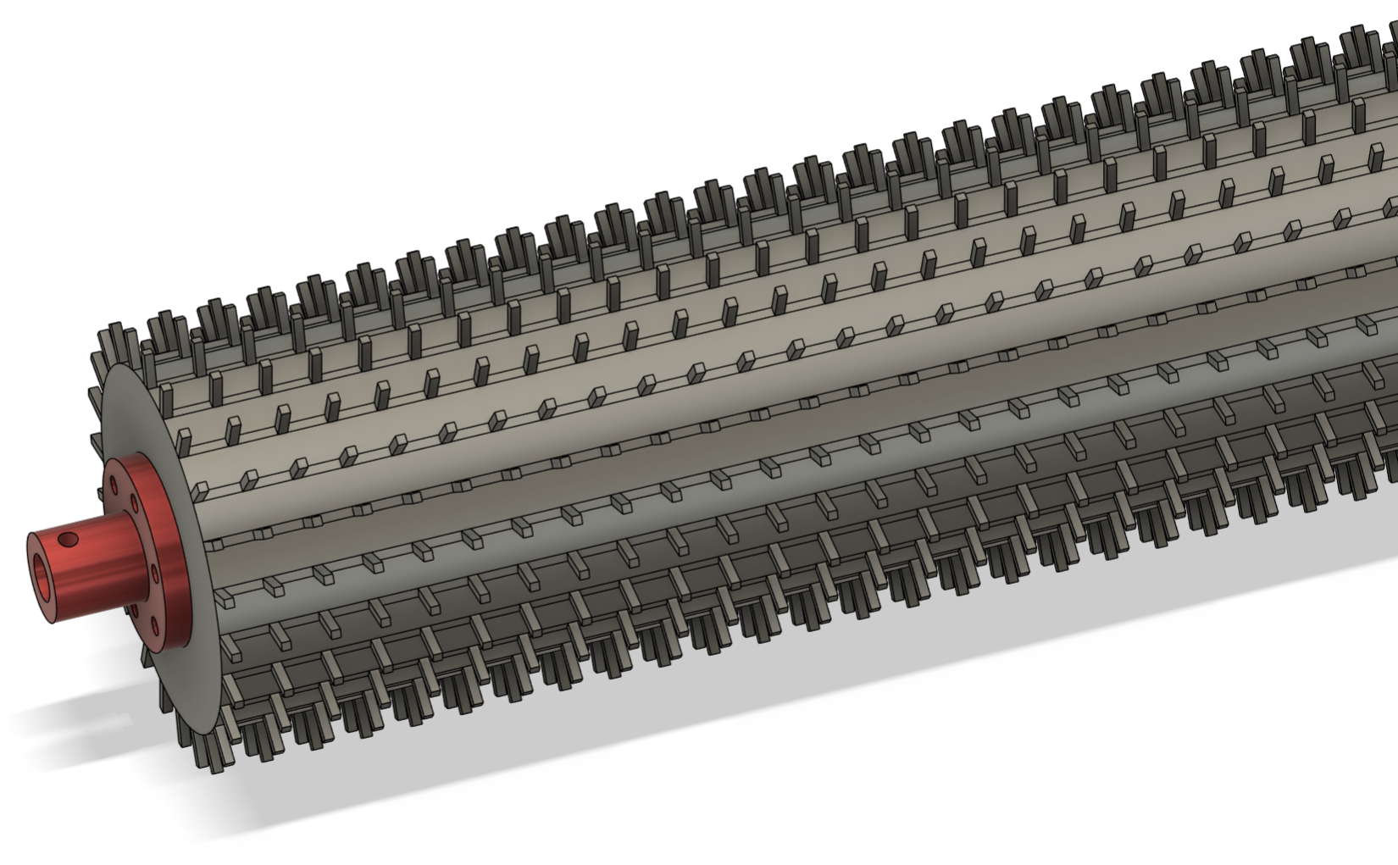
Product Architecture - Brush
Prepared by: Bowen Williamson
Presented by: Bowen Williamson
Radial Brush
Flange Coupling
12/6/2024
#16

Slide 17
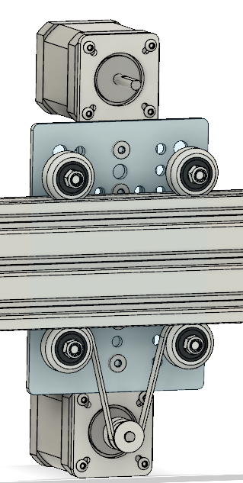
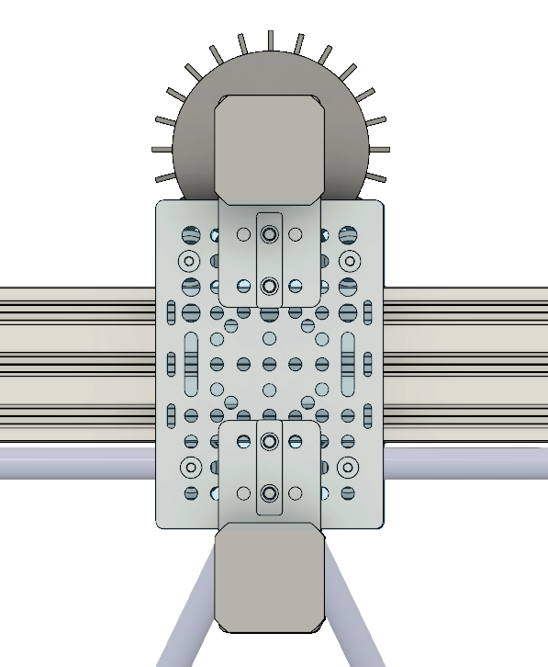
Product Architecture – Linear Actuator
Prepared by: Margaret Burkes
Presented by: Margaret Burkes
Rotational Motor
Brush
Gantry Plate
Wheel
Rails
Linear Motor
Belt
12/6/2024
#17

Slide 18
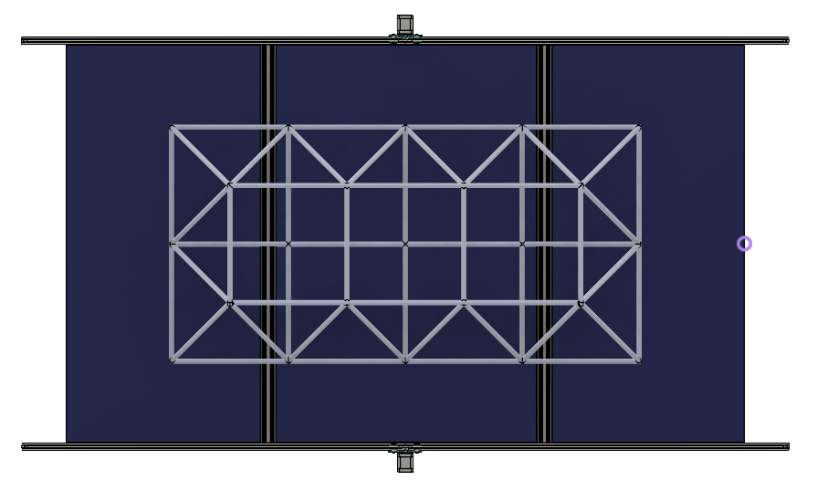
Product Architecture – Rover
Prepared by: Margaret Burkes
Presented by: William Mancuso
Mounting Bars
Linear Actuators
Rover Frame
12/6/2024
#18

Slide 19
Preliminary System Description
Prepared by: Bowen Williamson
Presented by: William Mancuso
Sources
Source Management
Distribution
To Rover
PWM Solar Charge Controller
Bus Bars
36V Battery
Solar Panel
Solar Panel Cleaning System
12/6/2024
#19

Slide 20
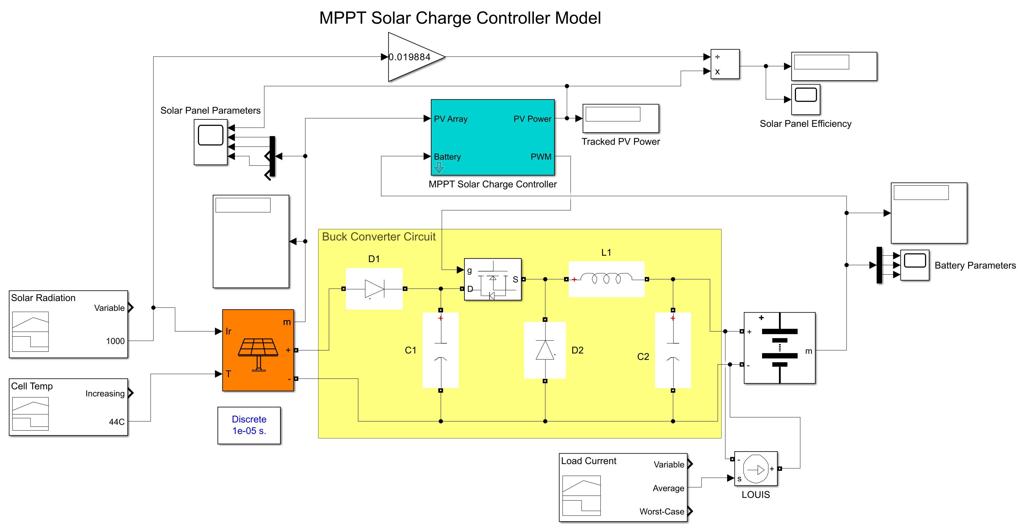
Engineering Analysis: Charge Controller
Prepared by: William Mancuso
Presented by: William Mancuso
12/6/2024
#20
Notes:
EXPLAIN WHERE NUMBERS COME FROM( SUNNY, CLOUDY, ETC.)

Slide 21
Engineering Analysis: Charge Controller
Prepared by: Bowen Williamson
Presented by: Bowen Williamson
Effects of Solar Radiation on Power Production
12/6/2024
#21

Slide 22
Engineering Analysis: Charge Controller
Prepared by: Bowen Williamson
Presented by: Bowen Williamson
Effects of Temperature on Solar Panel Efficiency
12/6/2024
#22

Slide 23
Engineering Analysis: Charge Controller
Prepared by: Bowen Williamson
Presented by: Bowen Williamson
12/6/2024
#23

Slide 24
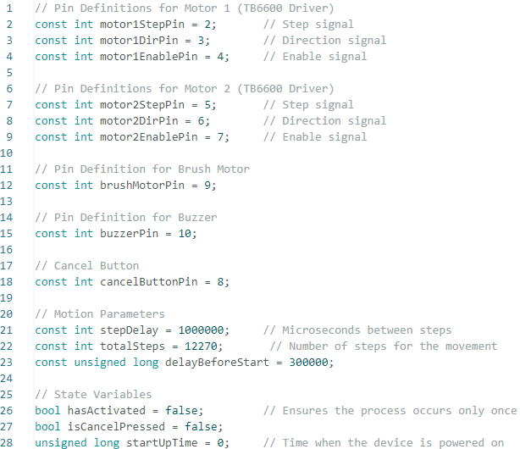
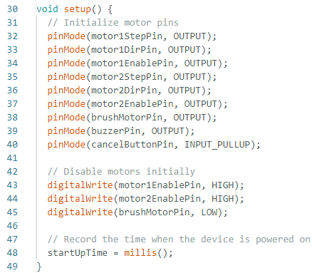
Engineering Analysis: Cleaning Activation
Prepared by: Kenny Bui
Presented by: Kenny Bui
Initializing Variables
Initializing Pins
12/6/2024
#24

Slide 25
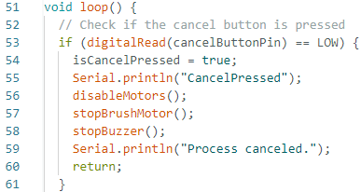
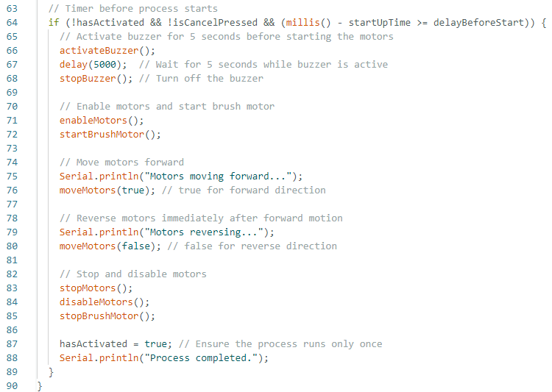
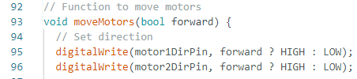
Engineering Analysis: Cleaning Activation
Prepared by: Kenny Bui
Presented by: Kenny Bui
Cancel Button Function
Timer and Main Body of Code:
Function to Move Motors
12/6/2024
#25

Slide 26
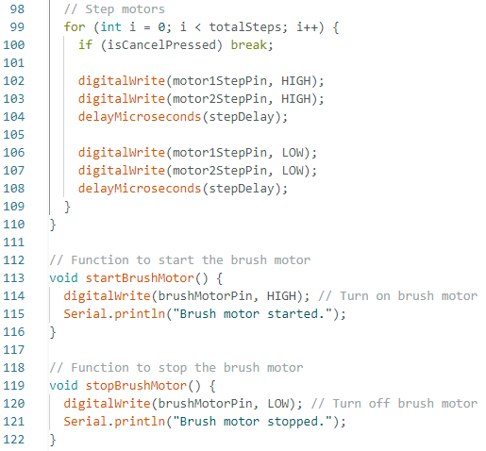
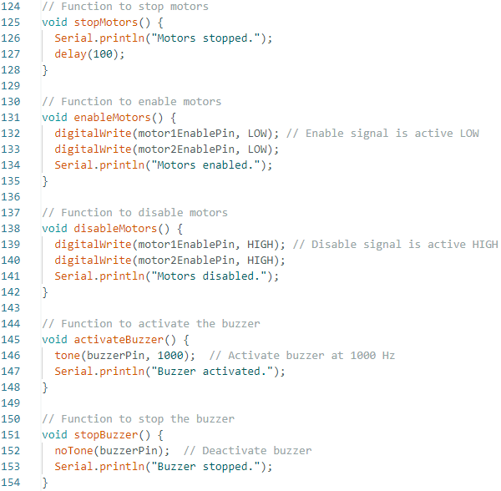
Engineering Analysis: Cleaning Activation
Prepared by: Kenny Bui
Presented by: Kenny Bui
Stepper Motor and Motor Function
Additional Motor Function
12/6/2024
#26

Slide 27
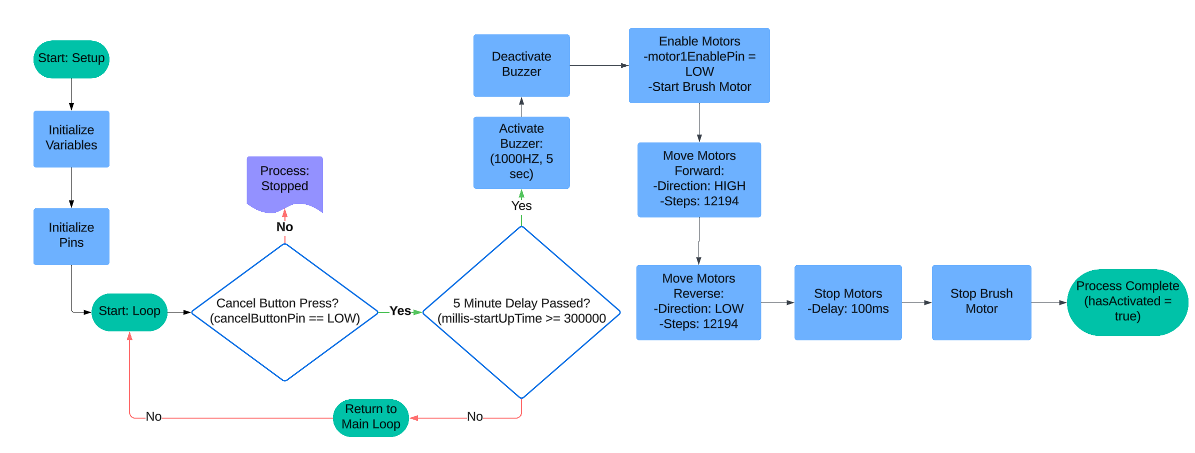
Engineering Analysis: Cleaning Activation
Prepared by: Kenny Bui
Presented by: Kenny Bui
12/6/2024
#27

Slide 28
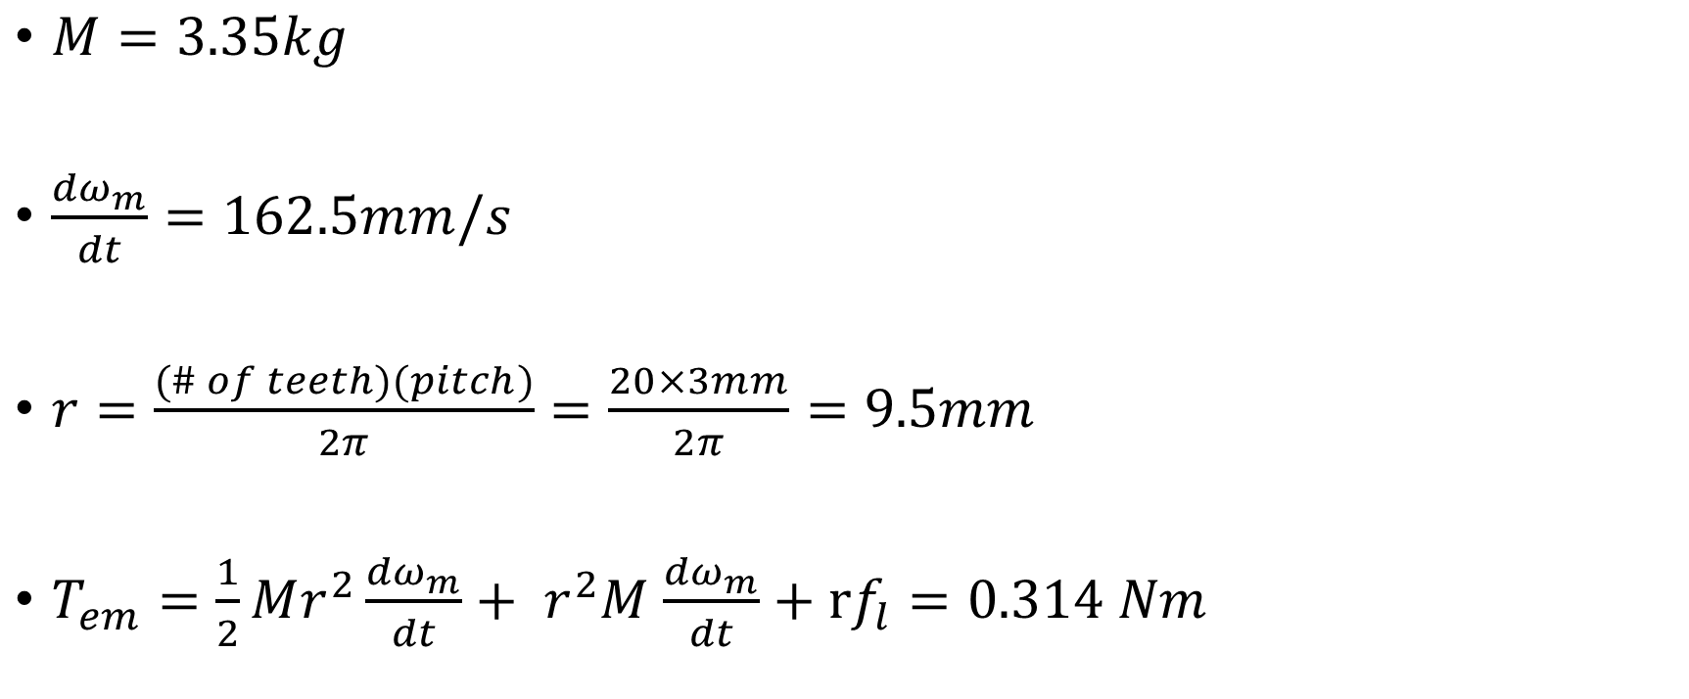
Engineering Analysis: Linear Motion Motor
Prepared by: Margaret Burkes
Presented by: Margaret Burkes
$M=3.35kg$
$\frac{{dω}_{m}}{dt}=162.5mm/s$
$r=\frac{(\# of teeth)(pitch)}{2π}=\frac{20×3mm}{2π}=9.5mm$
$T_{em}=\frac{1}{2}Mr^{2}\frac{{dω}_{m}}{dt}+ r^{2}M$ $\frac{{dω}_{m}}{dt}+rf_{l}=0.314 Nm$
12/6/2024
#28

Slide 29
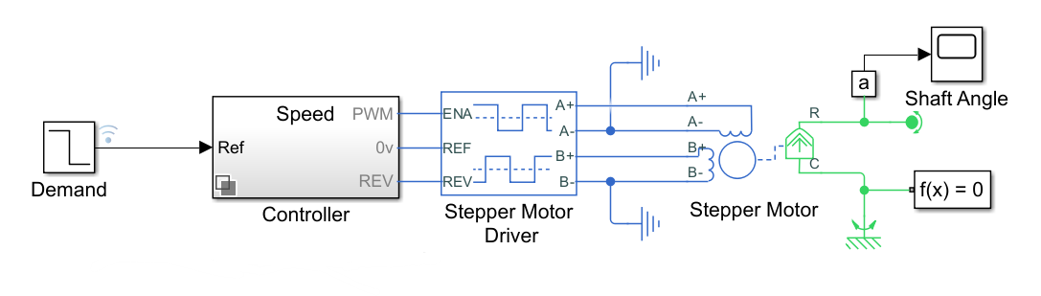
Engineering Analysis: Linear Motion Motor
Prepared by: Margaret Burkes
Presented by: Margaret Burkes
12/6/2024
#29

Slide 30
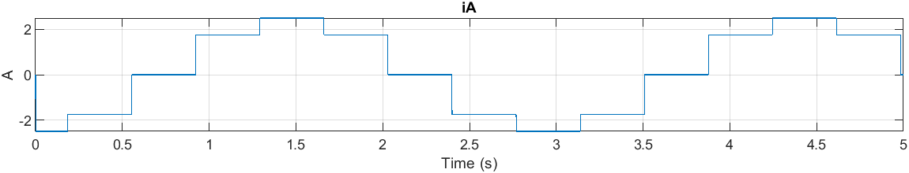
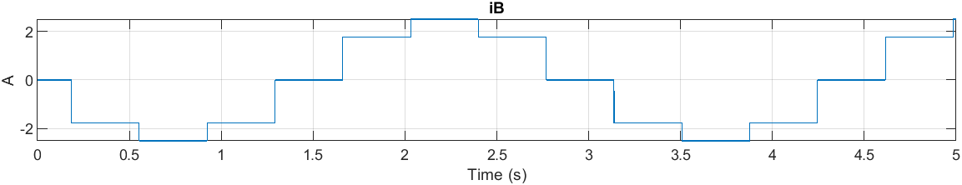
Engineering Analysis: Linear Motion Motor
Prepared by: Margaret Burkes
Presented by: Margaret Burkes
12/6/2024
#30

Slide 31
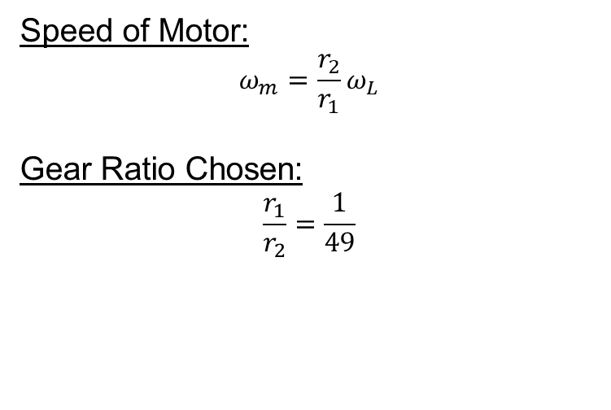
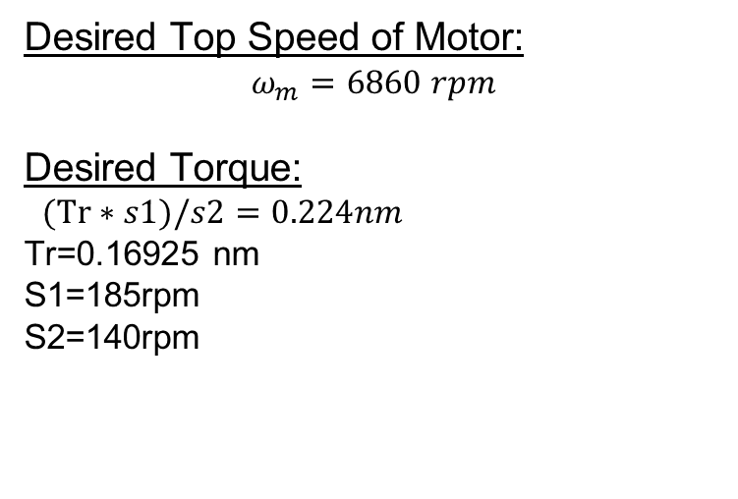
Engineering Analysis: DC Geared Motor
Prepared by: Keldon Ngo
Presented by: Keldon Ngo
12/6/2024
#31

Slide 32
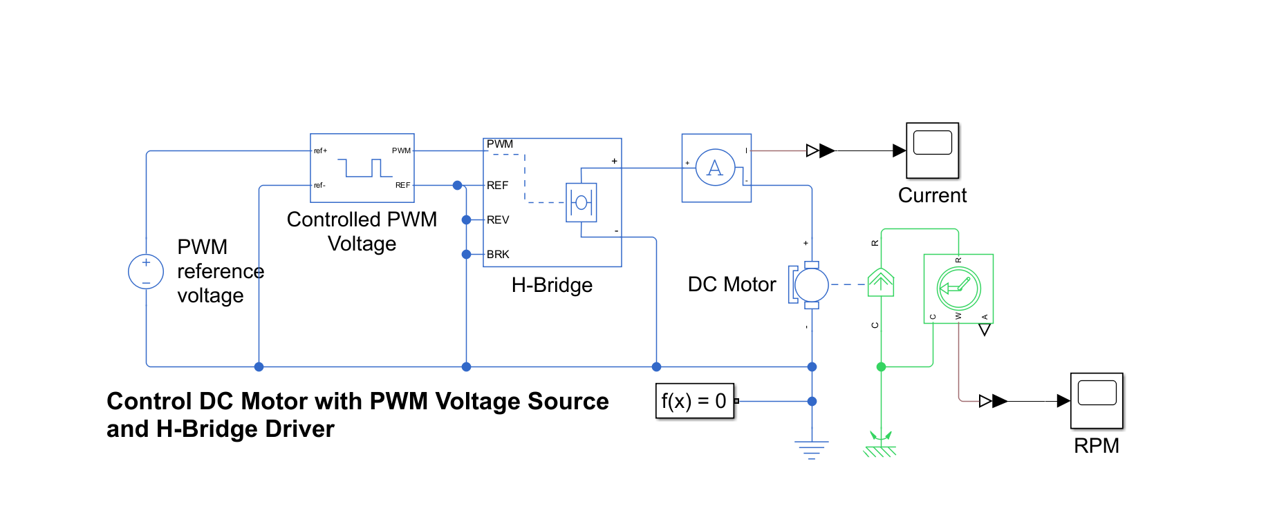
Engineering Analysis: DC Geared Motor
Prepared by: Keldon Ngo
Presented by: Keldon Ngo
12/6/2024
#32

Slide 33
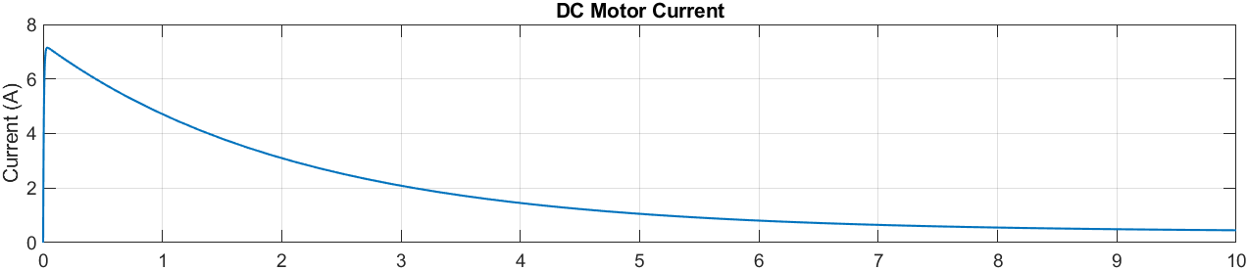
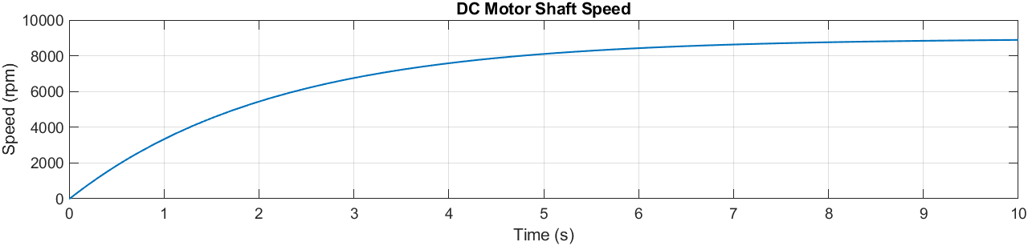
Engineering Analysis: DC Geared Motor
Prepared by: Keldon Ngo
Presented by: Keldon Ngo
12/6/2024
#33

Slide 34
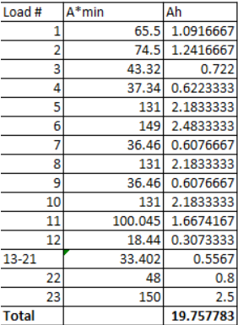
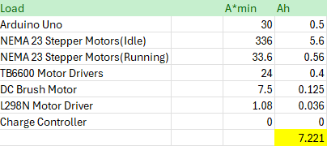
Engineering Analysis: Overall Circuit
Prepared by: Kenny Bui
Presented by: Kenny Bui
Original Circuit Load Analysis
Additional Circuit Load Analysis
*Load Calculation Conducted by Previous Group*
12/6/2024
#34

Slide 35
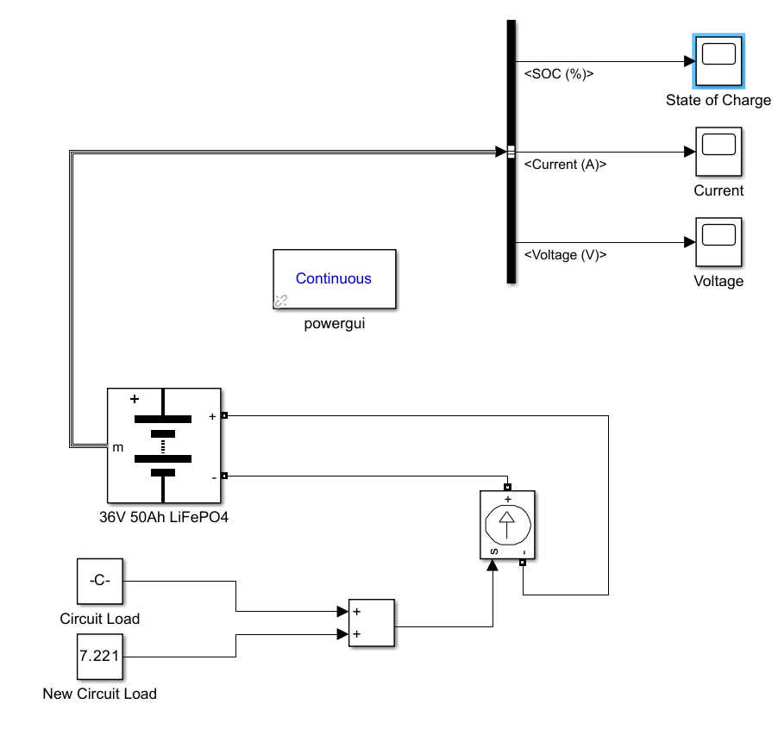
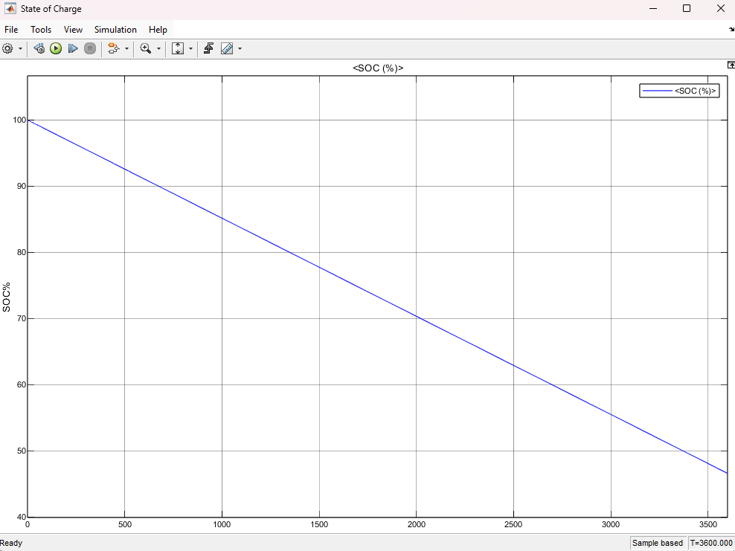
Engineering Analysis: Overall Circuit
Prepared by: Kenny Bui
Presented by: Kenny Bui
12/6/2024
#35

Slide 36
Component Evaluation: Solar Panel
Prepared by: Keldon Ngo
Presented by: Keldon Ngo
 |  | Concepts
Criterion | Weights | LG Neon | Candian Solar TOPHiKu6 | REC Alpha
Size | 40 | 0 | 0 | 1
Efficiency | 40 | -1 | 1 | 1
Cost | 20 | 0 | 0 | 1
Weighted Total | 100 | -0.4 | 0.4 | 1
12/6/2024
#36

Slide 37
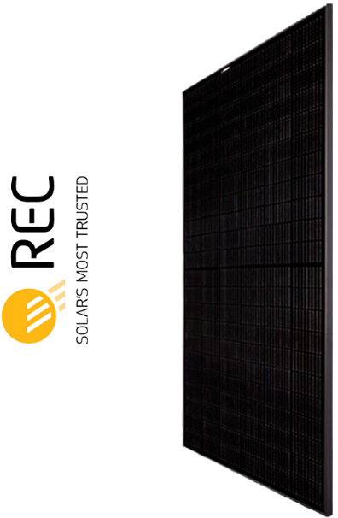
Component Selection: Solar Panel
Prepared by: Bowen Williamson
Presented by: Keldon Ngo
REC Pure-RX Solar Panel
Power Output | 450 W
Efficiency | 21.6%
Power Density | 20.1 W/m^2
Nominal Power Voltage | 54.3 V
Nominal Power Current | 8.29 A
12/6/2024
#37

Slide 38
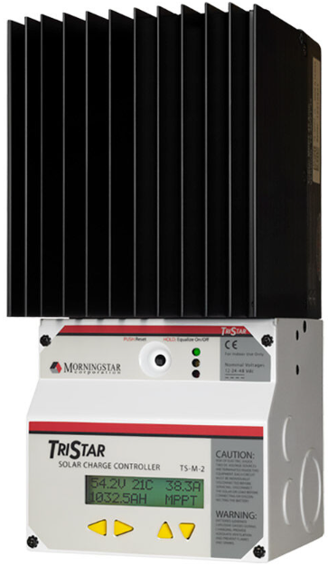
Component Selection: Solar Charge Controller
Prepared by: Bowen Williamson
Presented by: Bowen Williamson
MorningStar TriStar-MPPT-30
Operating Voltage | 9 V
Nominal Battery Voltage | 12, 24, 36, or 48 V
Charge Rating | 30 A
Max PV Power | 1200 W
Max PV Voc | 150 V
12/6/2024
#38

Slide 39
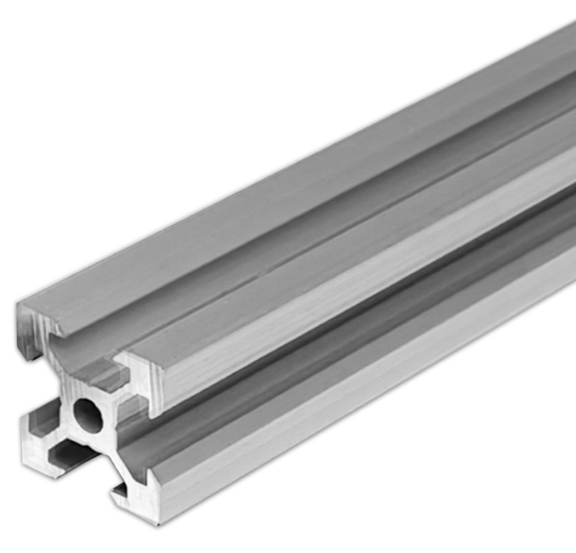
Component Selection: Mounting Rails
Prepared by: Bowen Williamson
Presented by: Bowen Williamson
OpenBuilds V-Slot Linear Rail
Size | 20x20 mm
Material | 6063 T-5 Aluminum
Length | Cut to length
12/6/2024
#39

Slide 40
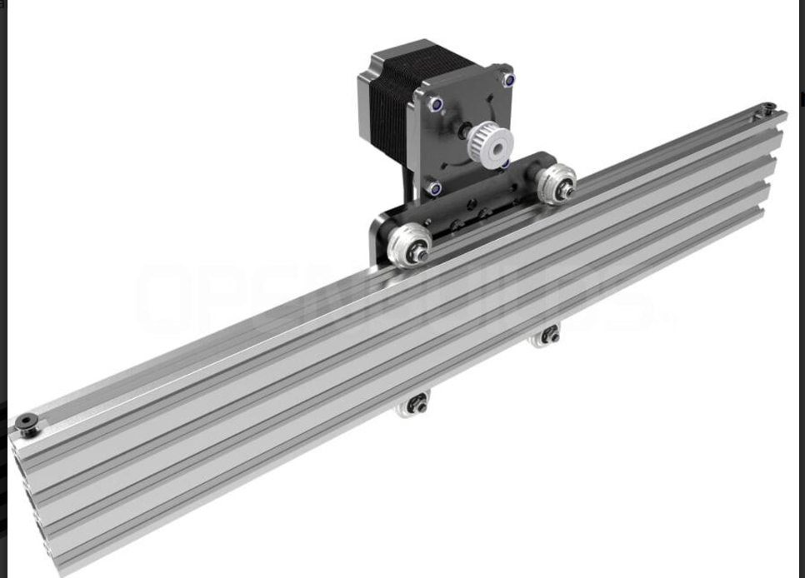
Component Selection: Linear Actuators
Prepared by: Bowen Williamson
Presented by: Bowen Williamson
OpenBuilds Belt & Pinion Actuator
Motor Size | NEMA 23
Rail Size | 20x80 mm
Length | 2000 mm
Max Force | 7.5 lb.
Max Speed | 10,000 mm/min
12/6/2024
#40

Slide 41
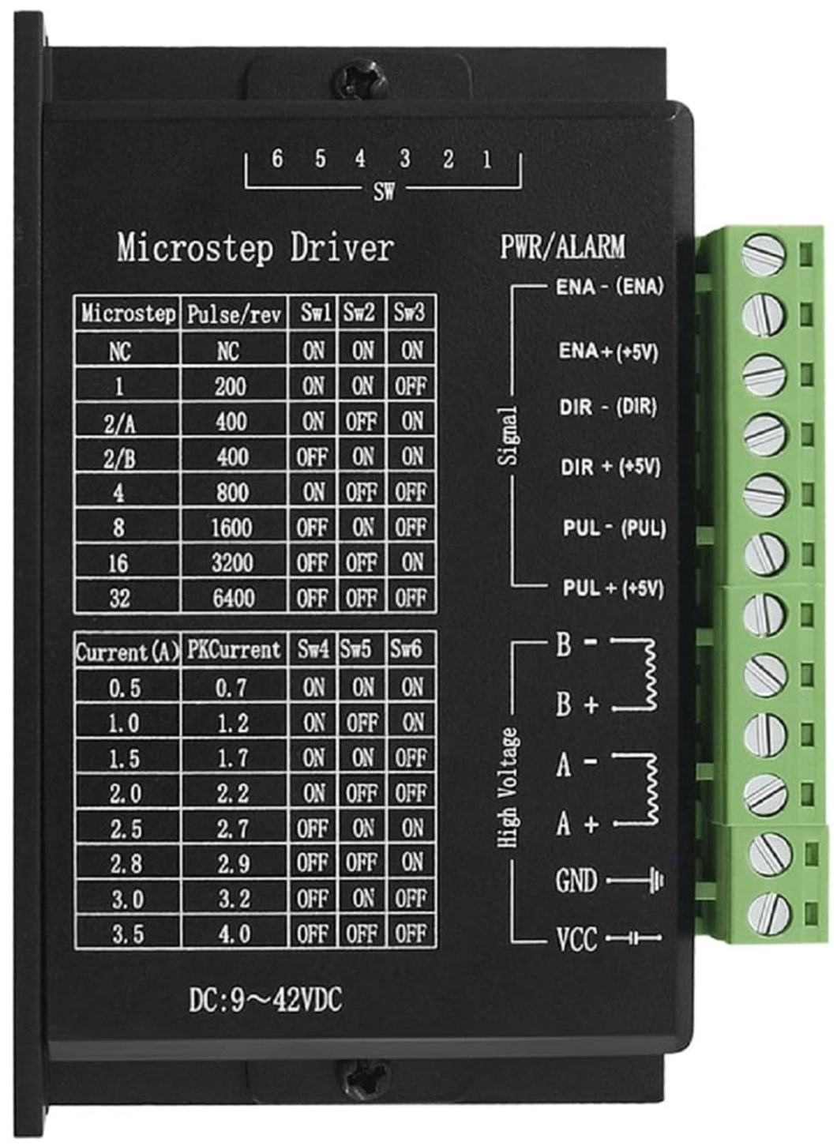
Component Selection: Stepper Motor Driver
Prepared by: Bowen Williamson
Presented by: Bowen Williamson
TB6600 Stepper Motor Driver
Operating Voltage | 9-42 V
Input Current | 1-4 A
Max Output Current | 3.5 A
Input Control Voltage | 5-24 V
Max Subdivision | 32 Microsteps
12/6/2024
#41

Slide 42
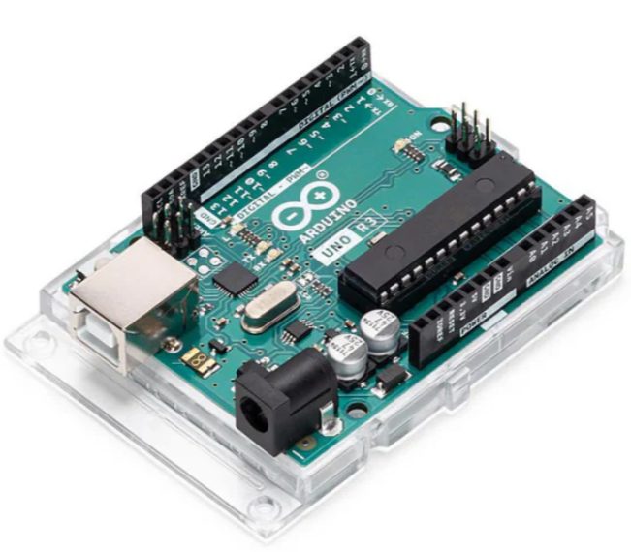
Component Selection: Arduino Microcontroller
Prepared by: Bowen Williamson
Presented by: Bowen Williamson
Arduino Uno REV3
Operating Voltage | 5 V
Digital I/O | 14 (6 provide PWM output)
Analog Input | 6
Input Control Voltage | 5-24 V
Max Subdivision | 32 Microsteps
12/6/2024
#42

Slide 43
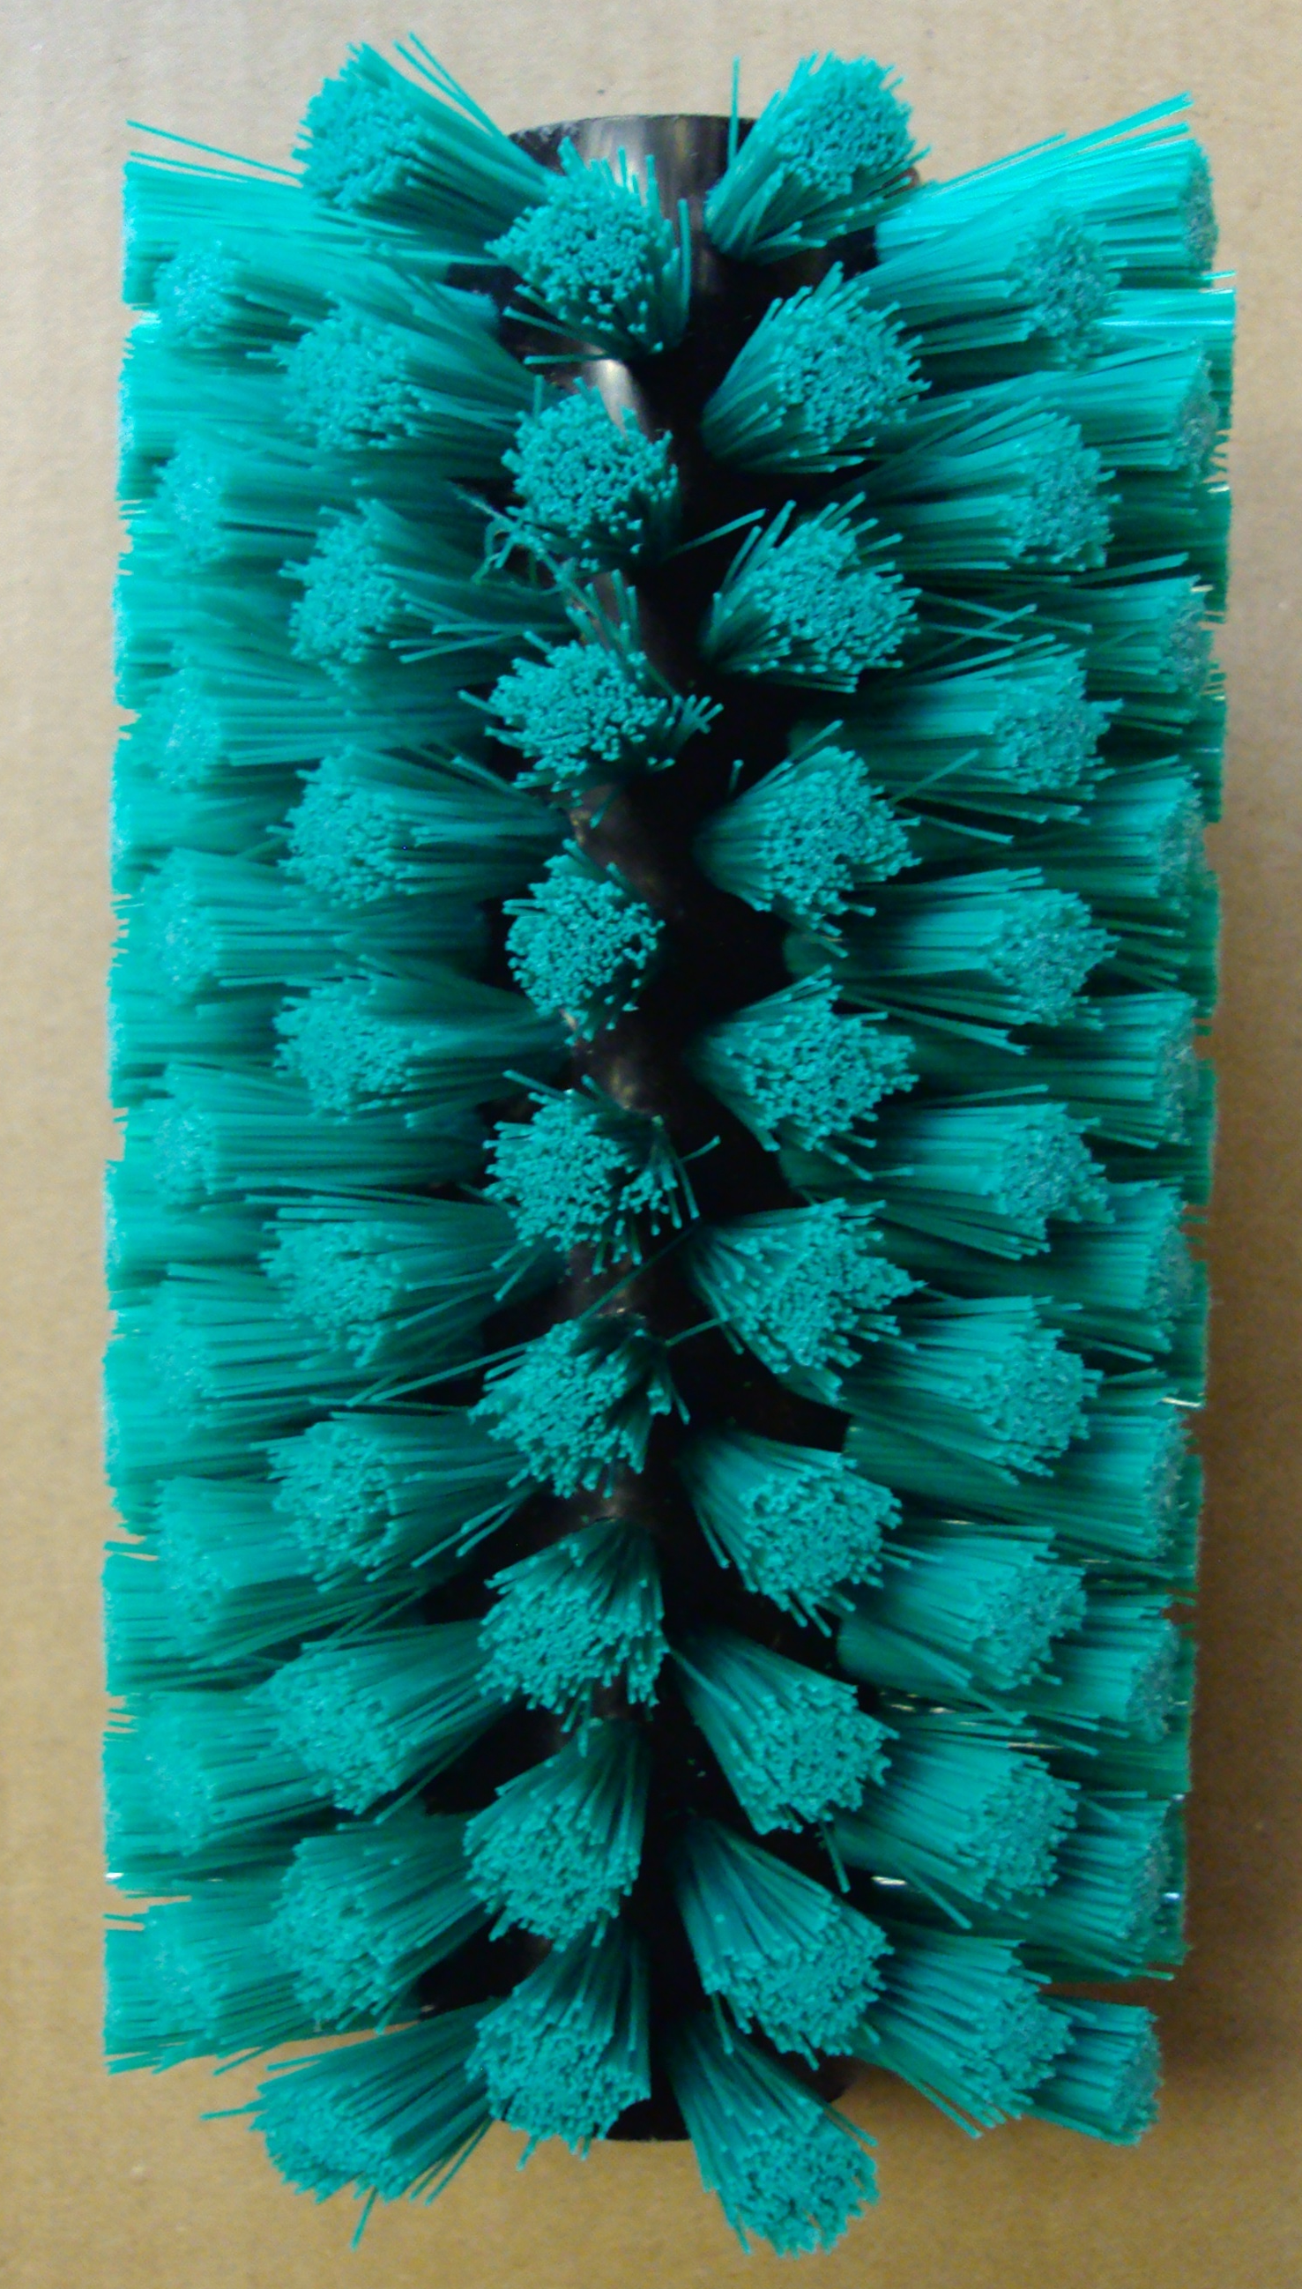
Component Selection: Cleaning Brush
Prepared by: Bowen Williamson
Presented by: Bowen Williamson
Industrial Brush Corp. Custom Brush
Type | Tufted Radial Brush
Material | 0.012in. Crimped Nylon
Length | 46 in.
Outer Diameter | 4 in.
12/6/2024
#43

Slide 44
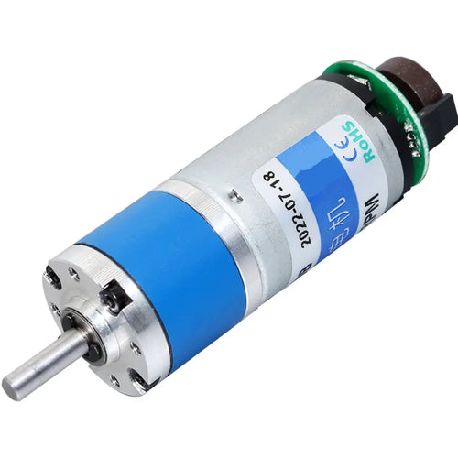
Component Selection: DC Brushed Motor
Prepared by: Bowen Williamson
Presented by: Bowen Williamson
21mm Planetary Gear Motor w/ 12V Encoder, 185RPM
Operating Voltage | 1-12 V
Input Current | 0.09-2.5 A
Max Current at Stall | 2.5A
Toque | 2 kgf/cm
Speed(Rated) | 7812RPM
12/6/2024
#44

Slide 45
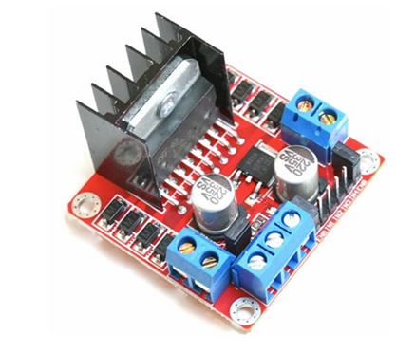
Component Selection: Brushless Motor Driver
Prepared by: Bowen Williamson
Presented by: Bowen Williamson
L298N Dual H-Bridge Motor Driver
Operating Voltage | 3.2-40 V
Input Current | 0-36 mA
Max Output Current | 2 A
Input Control Voltage | 3.2-40 V
Max power consumption | 20W
12/6/2024
#45

Slide 46
Manufacturing Plan: The Brush
Prepared by: William Mancuso
Presented by: William Mancuso
12/6/2024
#46

Slide 47
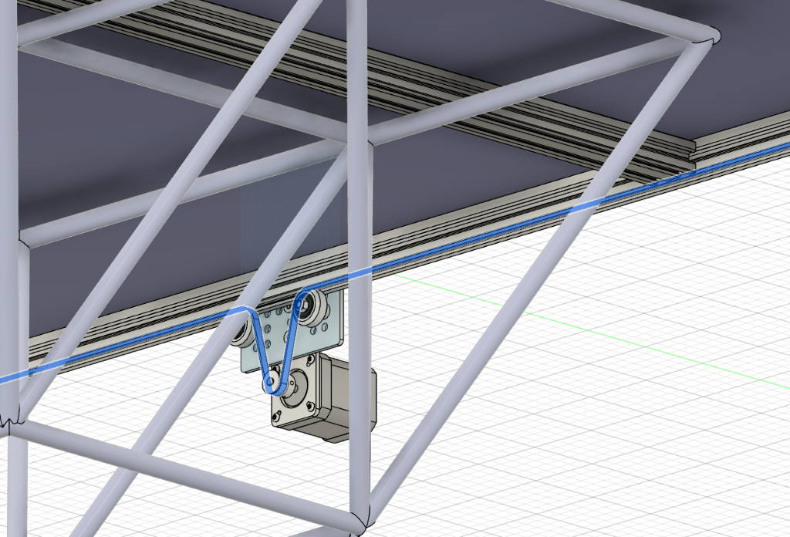
Manufacturing Plan: Cleaning System
Prepared by: William Mancuso
Presented by: William Mancuso
12/6/2024
#47

Slide 48
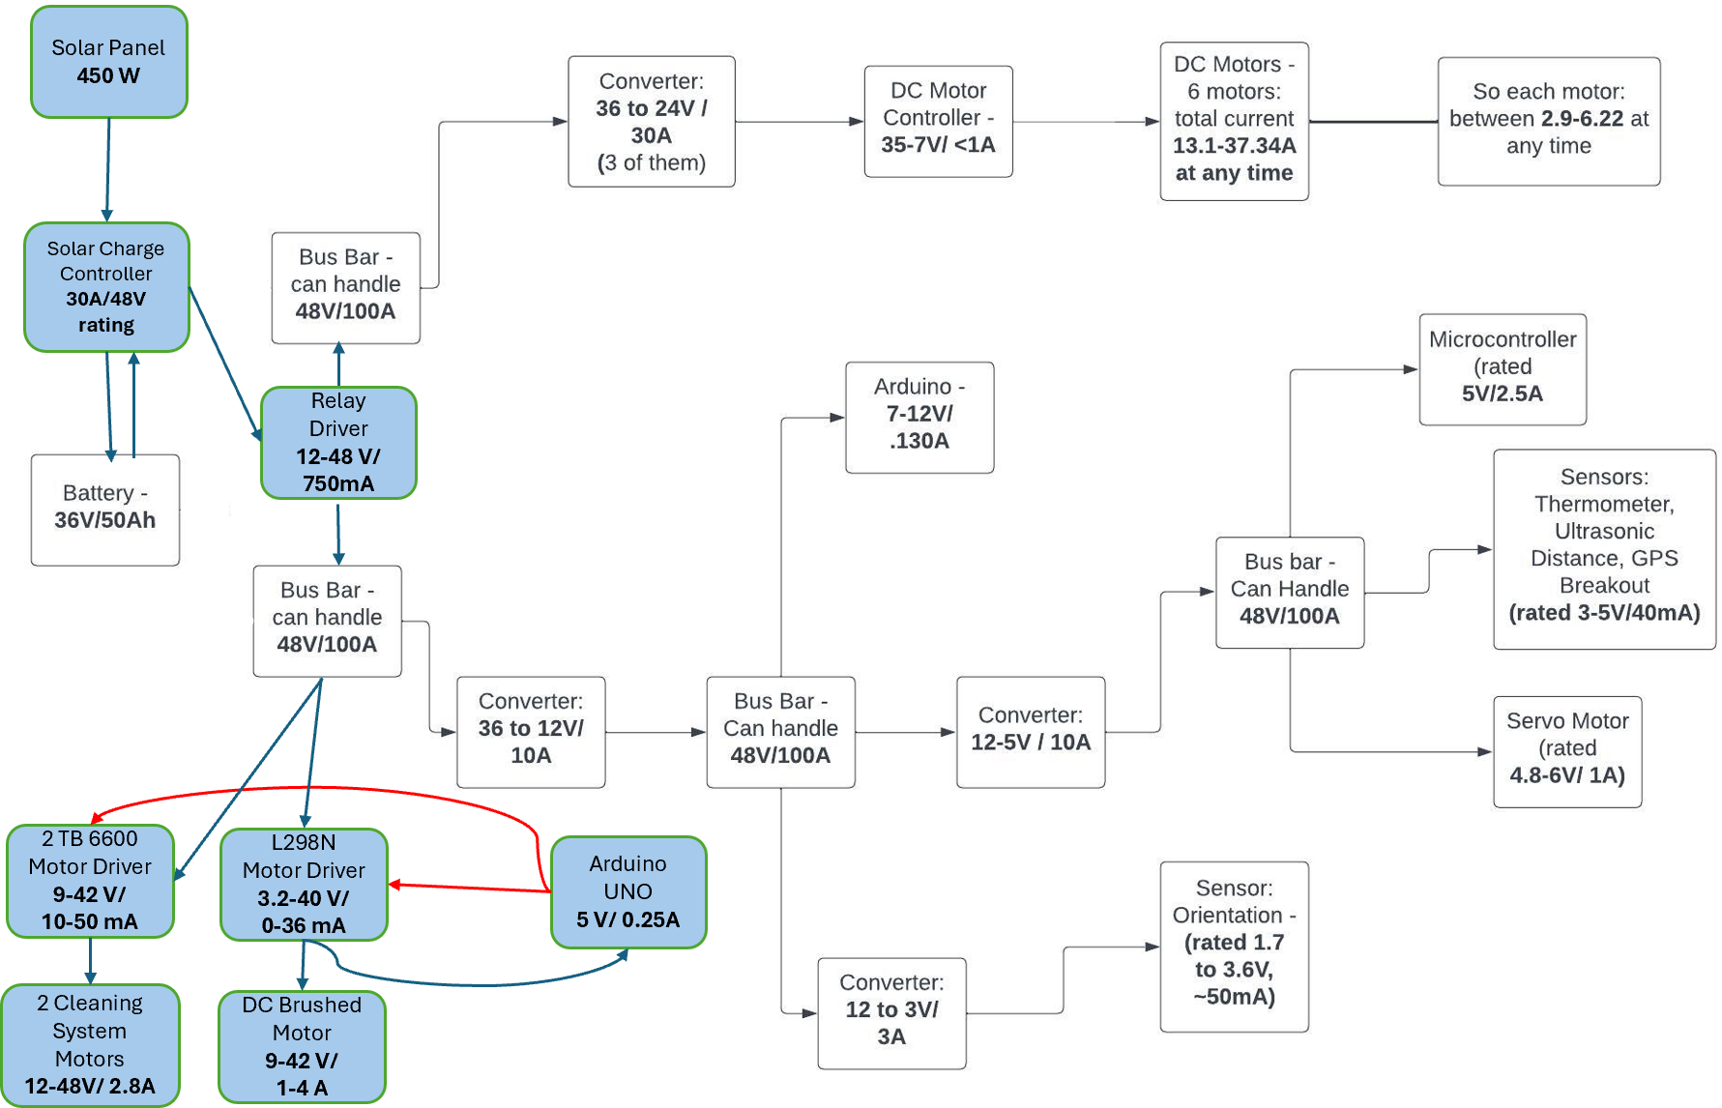
Manufacturing Plan: Wiring Changes & Electrical Connections
Prepared by: William Mancuso
Presented by: William Mancuso
KEY
Blue box | New Component
Blue Arrow | New Electrical Wiring
Red Arrow | New Signal Wiring
12/6/2024
#48

Slide 49
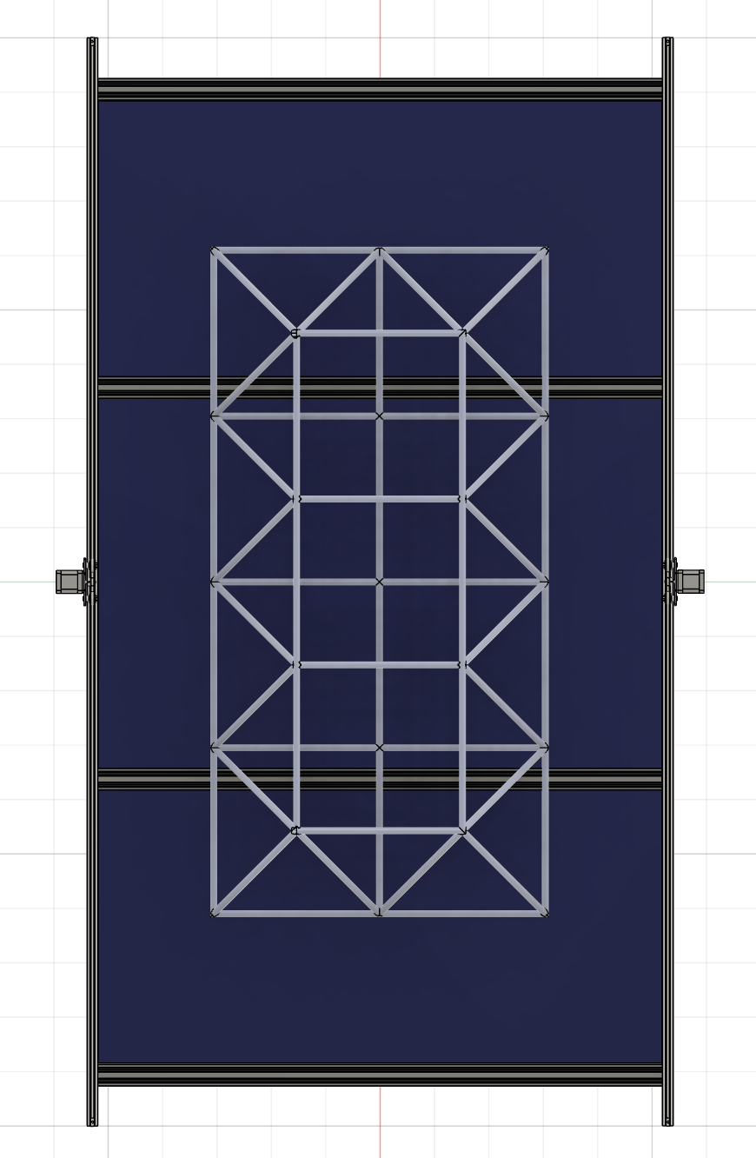
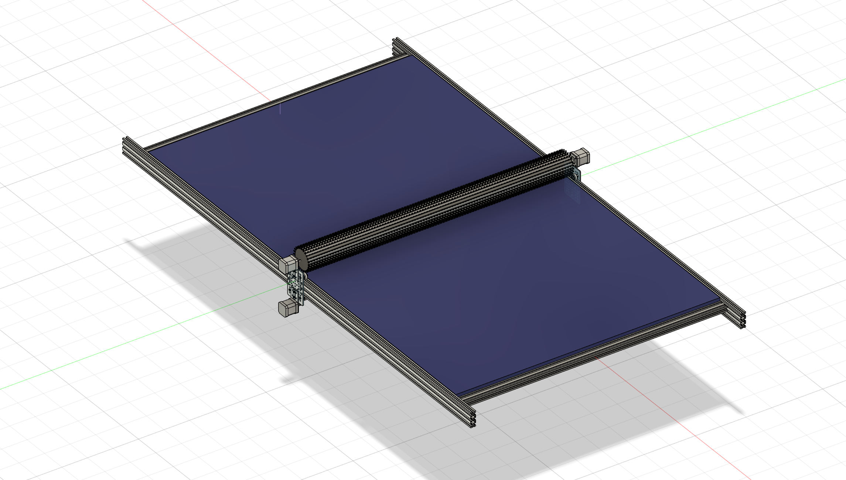
Manufacturing Plan: Solar Panel Mounting
Prepared by: William Mancuso
Presented by: William Mancuso
12/6/2024
#49

Slide 50
Testing and Validation Plan:
Prepared by: Keldon Ngo
Presented by: Keldon Ngo
Battery Runtime
Analyze state of charge while having the rover preform at full capacity
Environment performance
Bring the solar panel outside during peak sun irradiation and measure power output
Cleaning system
Add debris to the panel to test the effectiveness of the brush
Run the cleaning system without attachment to the solar panel to ensure its status
12/6/2024
#50

Slide 51
Safety Considerations:
Prepared by: Kenny Bui
Presented by: Kenny Bui
Concern | Safety Preventative
Electrical Shock Hazard | All electrical connections on our rover are properly grounded to prevent shock hazard.
Overcurrent | All major electrical components have incorporated fused connections that are sized properly and are expected to pop in the case of overcurrent.
Moving object hazard with motors on cleaning system | There is a cancel button designed in the brush cleaning system that is designed to cancel all operation of the cleaning system in case it is needed.
Unexpected cleaning system activation | There is also a buzzer designed to trigger before the cleaning system is activated to alert all nearby prior to the cleaning system activating.
Kill Switch | There are two switches attached to the battery that can be quickly disengaged to de-energize the entire rover in the case that it is needed
12/6/2024
#51

Slide 52

Environmental Impact Assessment
Prepared by: Bowen Williamson
Presented by: Bowen Williamson
• Decrease in power required from the grid
• Recyclable components
• Emission-free operation
Dry cleaning; no harmful chemicals
12/6/2024
#52

Slide 53
Budget
Prepared by: Bowen Williamson
Presented by: Bowen Williamson
Allotted Budget: $4000
Expected Total Cost: $1195
Generous Donations:
MorningStar
•TriStar Solar Charge Controller ($293)
REC Solar
•450W Pure-RX Solar Panel ($234)
12/6/2024
#53

Slide 54
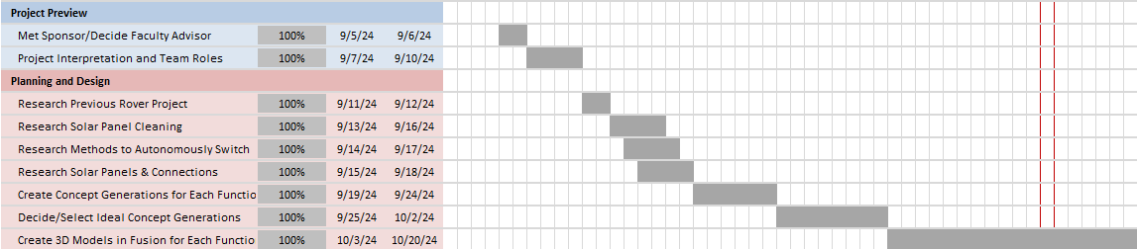
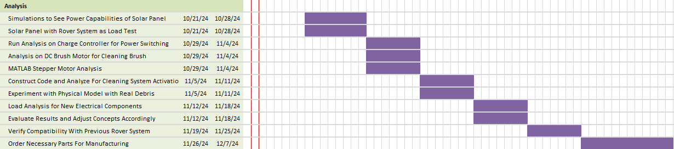
Timeline:
Prepared by: Kenny Bui
Presented by: Kenny Bui
12/6/2024
#54

Slide 55


Timeline Cont.:
Prepared by: Kenny Bui
Presented by: Kenny Bui
12/6/2024
#55

Slide 56
Appendix:
Nema 23 Stepper Motor
Concept Generation: Solar Panel
Concept Evaluation & Selection: Solar Panel
Concept Generation: Autonomous Power Switching
Concept Evaluation & Selection: Autonomous Power Switching
Stepper Motor Simulation Blocks
Controller’s Step Rate and Direction
Controller’s Voltage-Controlled Pulse Generator
Stepper Motor’s Shaft Angle
Stepper Motor’s Shaft Speed
Stepper Driver’s Pin Voltages
12/6/2024
#56

Slide 57
Appendix:
Stepper Motor’s Reverse Charts #1
Stepper Motor’s Reverse Charts #2
Stepper Motor’s Total Number of Steps
Electrical Connections Before Add-ons
New Addition Load Analysis Calculations
12/6/2024
#57

Slide 58
Concept Generation: Solar Panel
Prepared by: Keldon Ngo
Presented by: Keldon Ngo
Thin-Film Panel
Polycrystalline Panel
Mono crystalline Panel
12/6/2024
#58

Slide 59
Concept Evaluation & Selection: Solar Panel
Prepared by: Keldon Ngo
Presented by: Keldon Ngo
 |  | Concepts
Criterion | Weights | Thin Film | Polycrystalline | Monocrystalline
Efficiency | 40 | -1 | 0 | 1
Cost | 25 | 1 | 0 | -1
Weight | 20 | 1 | -1 | -1
Life-span | 15 | -1 | 1 | 1
Weighted Total | 100 | -.1 | -.05 | 0.1
12/6/2024
#59

Slide 60
Concept Generation: Autonomous Power Switching
Prepared by: William Mancuso
Presented by: William Mancuso
Voltage Regulator with Arduino
DC/DC Controller with Arduino
Solar Charge Controller
12/6/2024
#60

Slide 61
Concept Evaluation & Selection: Autonomous Power Switching
Prepared by: William Mancuso
Presented by: William Mancuso
 |  | Concepts
Criterion | Weights | Voltage Regulator with Arduino | DC/DC Converter with Arduino | Solar Charge Controller
Functional Accuracy | 45 | -1 | 0 | 1
Simplicity | 25 | 0 | -1 | 1
Programmability | 20 | -1 | 0 | 1
Cost | 10 | 1 | 0 | -1
Weighted Total | 100 | -0.55 | -0.25 | 0.8
12/6/2024
#61

Slide 62


Nema 23 Stepper Motor
Prepared by: Margaret Burkes
Presented by: Margaret Burkes
Items | Specs
Phase Number | 2 phases
Driving Voltage | 12-48V
Resistance(20$℃$) | 1.1$±$10% $Ω$ / phase
Holding Torque | 175 Oz.in
Detent Torque | 400 g.cm
Rotor Inertia | 300 g.${cm}^{2}$
Step Angle | $1.8°±$ 5%
Rated Current | 2.8A / phase
Inductance | 3.0$±$20% mH/ phase
Weight | 0.75 kg
12/6/2024
#62

Slide 63



Stepper Motor Simulation Blocks
Prepared by: Margaret Burkes
Presented by: Margaret Burkes
12/6/2024
#63

Slide 64

Controller’s Step Rate and Direction
Prepared by: Margaret Burkes
Presented by: Margaret Burkes
12/6/2024
#64

Slide 65

Controller’s Voltage-Controlled Pulse Generator
Prepared by: Margaret Burkes
Presented by: Margaret Burkes
12/6/2024
#65

Slide 66

Stepper Motor’s Shaft Angle
Prepared by: Margaret Burkes
Presented by: Margaret Burkes
12/6/2024
#66

Slide 67

Stepper Motor’s Shaft Speed
Prepared by: Margaret Burkes
Presented by: Margaret Burkes
MAX: 894.3 deg/s
12/6/2024
#67

Slide 68

Stepper Driver’s Pin Voltages
Prepared by: Margaret Burkes
Presented by: Margaret Burkes
12/6/2024
#68

Slide 69


Stepper Motor’s Reverse Charts #1
Prepared by: Margaret Burkes
Presented by: Margaret Burkes
MIN: -894.4 deg/s
12/6/2024
#69

Slide 70


Stepper Motor’s Reverse Charts #2
Prepared by: Margaret Burkes
Presented by: Margaret Burkes
12/6/2024
#70

Slide 71

Stepper Motor’s Total Number of Steps
Prepared by: Margaret Burkes
Presented by: Margaret Burkes
$Forward Distance=1840mm$
$Microsteps per Revolution=200\frac{steps}{revolution} ×2\frac{microsteps}{step}=400\frac{microsteps}{revolution}$
$Circumference=2π×9.55mm=59.98 mm$
$Distance per Microstep=\frac{Circumference}{\frac{Microsteps}{Revolution}}=\frac{59.98mm}{400 microsteps/revolution}=0.14995\frac{mm}{microstep}$
${Microsteps}_{Forward}=\frac{Forward distance}{Distance/Microstep}=\frac{1840mm}{0.14995 mm/microstep}=12270 microsteps$
$Total \# of Microsteps={Microsteps}_{Forward}×2=24540 microsteps$
12/6/2024
#71

Slide 72

Electrical Connections Before Add-ons
Prepared by: William Mancuso Presented by: William Mancuso
12/6/2024
#72

Slide 73
New Addition Load Analysis Calculations
Prepared by: Kenny Bui
Presented by: Kenny Bui
(2) TB6600 Motor Driver: 2 x 200mA = 0.4A
0.4A x 3 minutes = 1.2A
1.2A ÷ 60 minutes = 0.02Ah
DC Motor: 2.5A x 3 minutes = 7.5A
7.5A ÷ 60 minutes = 0.125Ah
12/6/2024
#73

